Slide 1

Design and Implementation of an Intrusion Detection and Prevention Monitoring System
Presented by
ABOUHANE Zahra
BAZGOUR Yassine
Before
Prof. OUAISSA Mariya
Prof. ELBACHARI Essaid

Slide 2
Outline
General Context of The Project
Generalities of The Project
Implementation of Snort IDS
Implementation of a Monotoring and Log Management System
General Conclusion

Slide 3
General Context of the Project
Objectives
Design and implement a comprehensive monitoring system for IDPS.
Enhance accuracy and efficiency in detecting cyber threats.
Integrate real-time monitoring and automated response mechanisms.
Evaluate system performance and effectiveness in a controlled environment.

Slide 4


General Context of the Project
Problematic
Solution

Slide 5
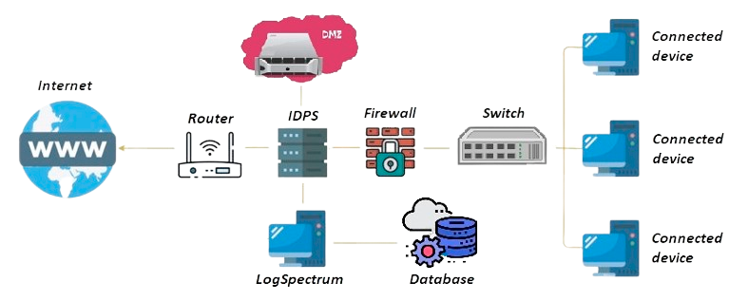
General Context of the Project
System Architecture

Slide 6
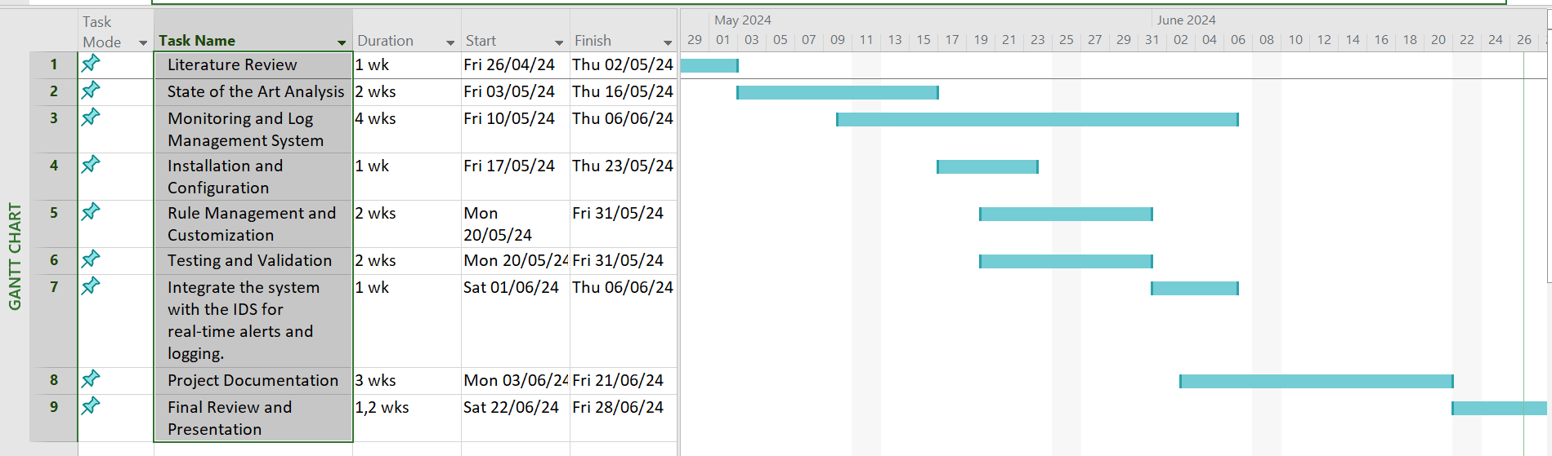
General Context of the Project
Project Planning

Slide 7

Generalities

Slide 8



Generalities
Common cybersecurity terminology
Firewall Encryption DMZ

Slide 9




Generalities
Types of cybersecurity threats:
DOS Malware Phishing MITM

Slide 10

Generalities

Slide 11



Generalities Comparative Study of Intrusion Detection Systems

Slide 12
Implementation of Snort IDS

Slide 13
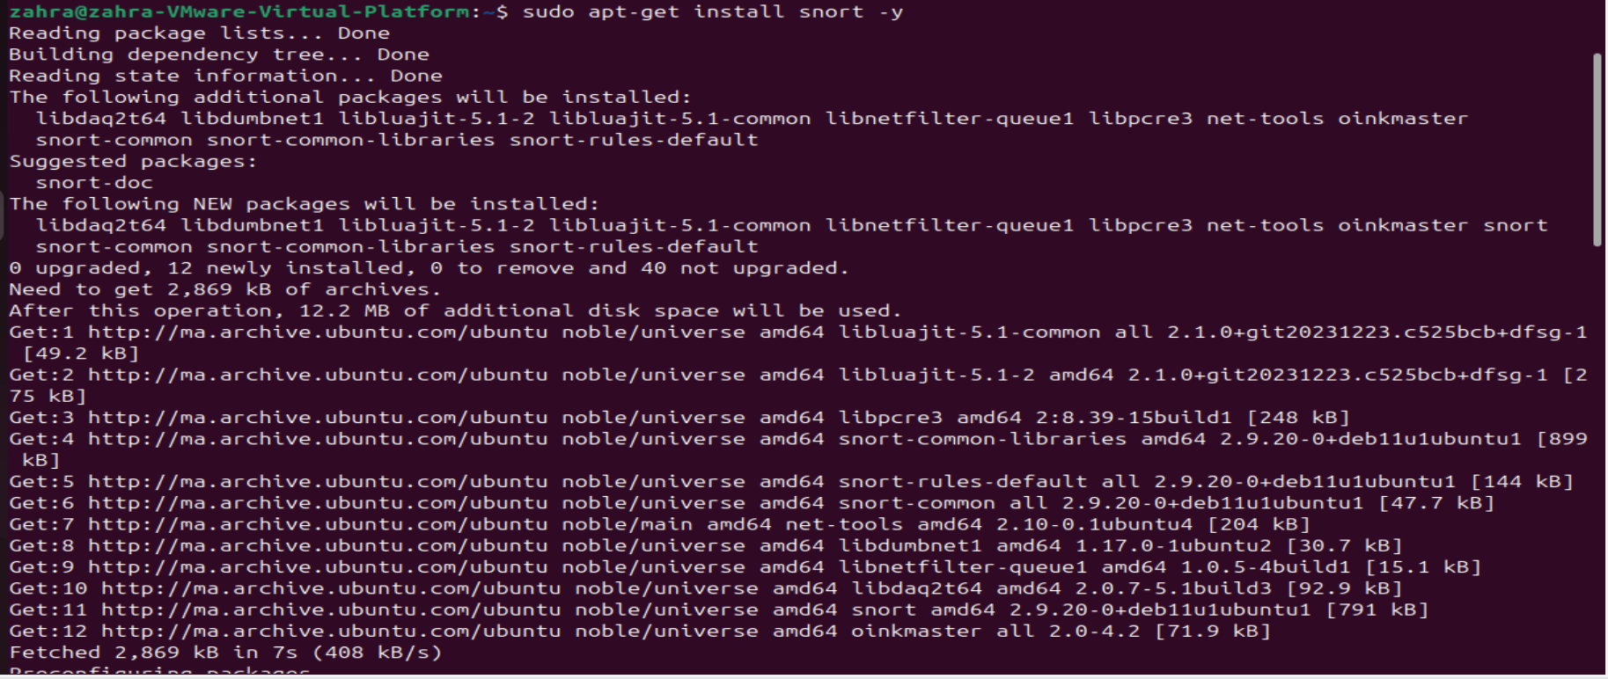
Implementation of Snort IDS
Installation:

Slide 14
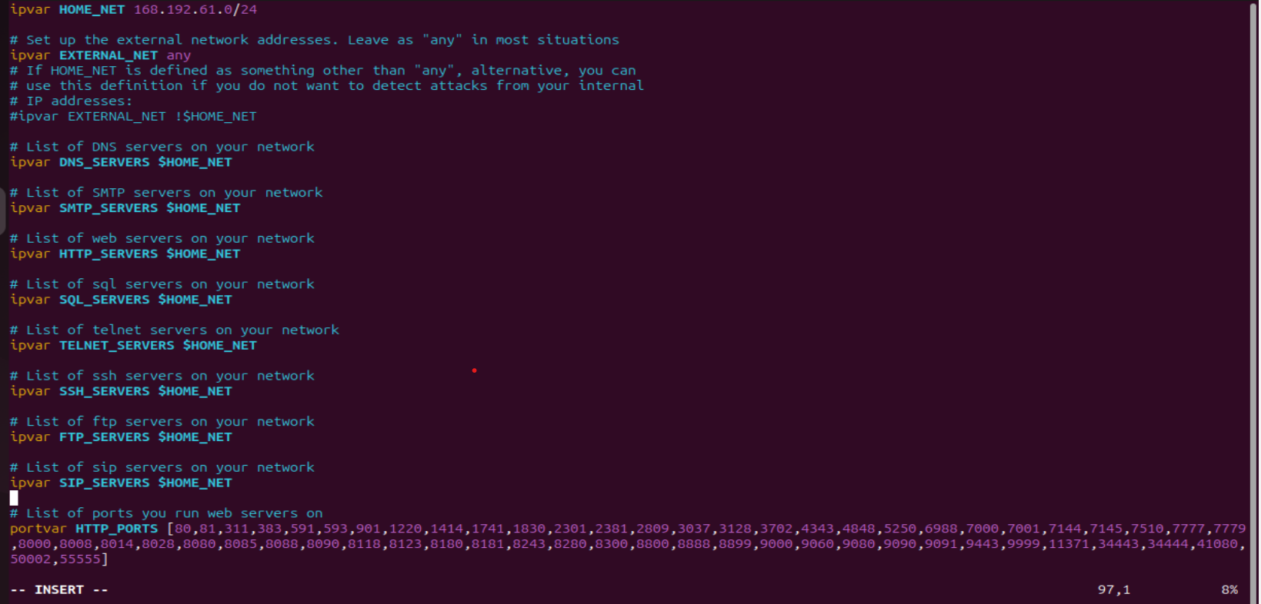
Implementation of Snort IDS
Configuration:

Slide 15

Implementation of Snort IDS
Configuration:

Slide 16
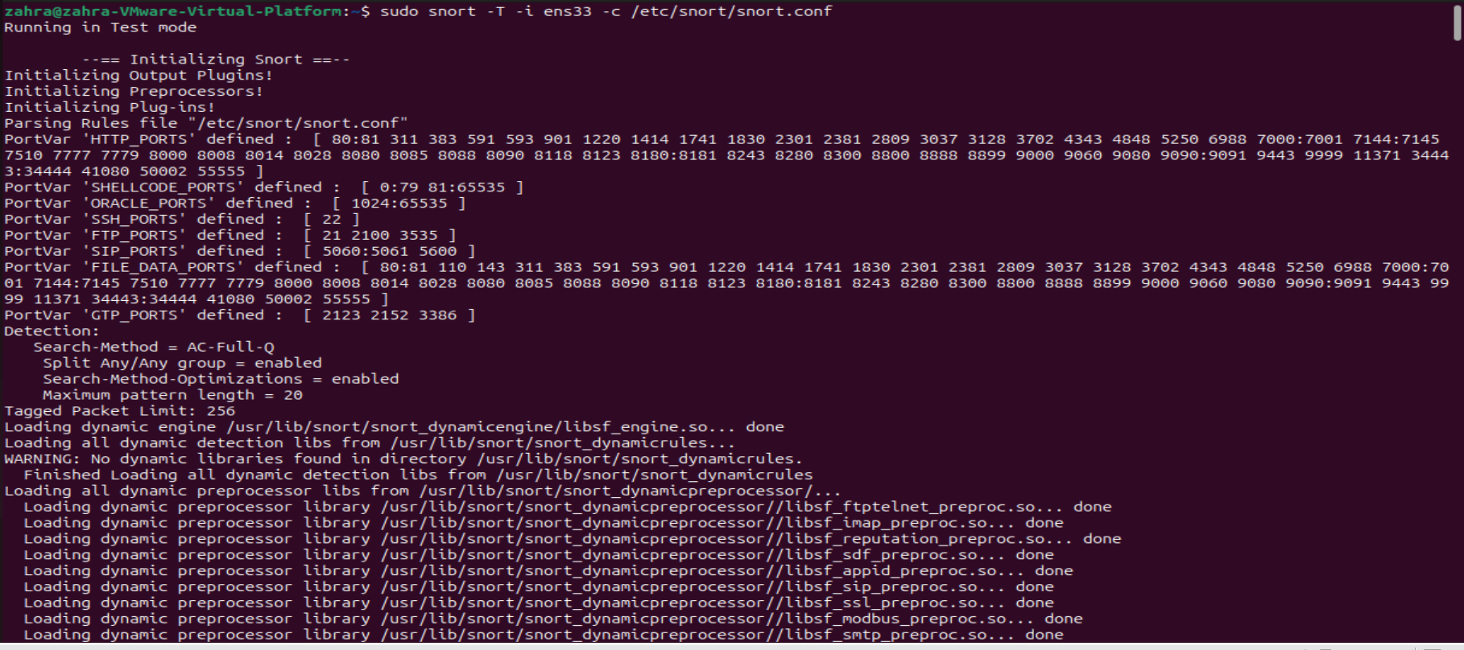
Implementation of Snort IDS
Run in test mode:

Slide 17
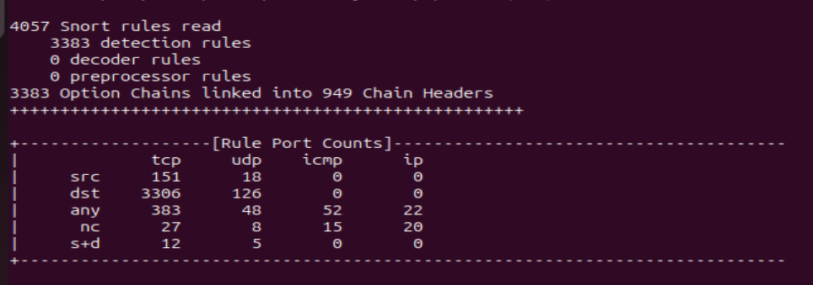
Implementation of Snort IDS
Run in test mode:

Slide 18
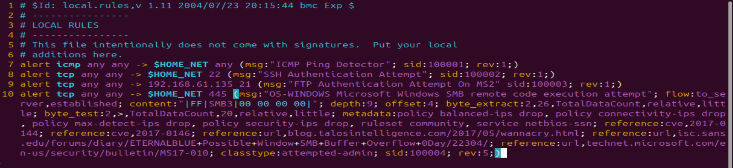
Implementation of Snort IDS
Rule management:

Slide 19
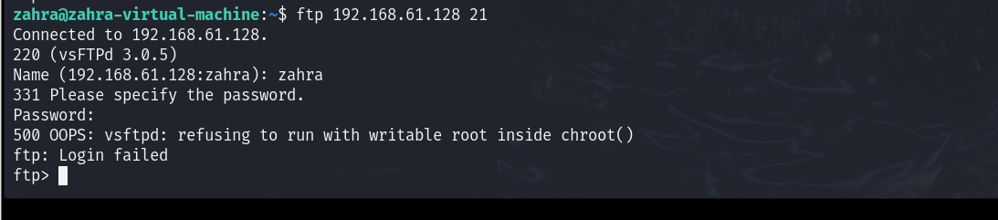
Implementation of Snort IDS
Running attacks:

Slide 20
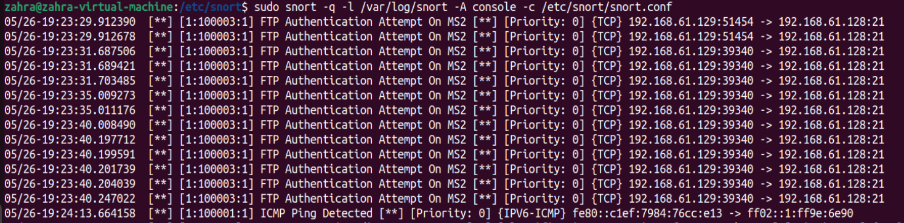
Implementation of Snort IDS
Running attacks:

Slide 21
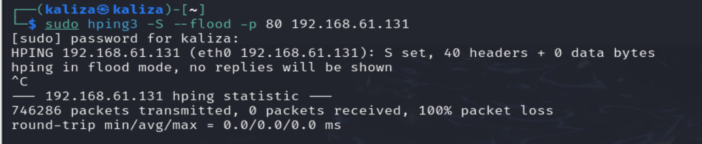
Implementation of Snort IDS
Running attacks:

Slide 22
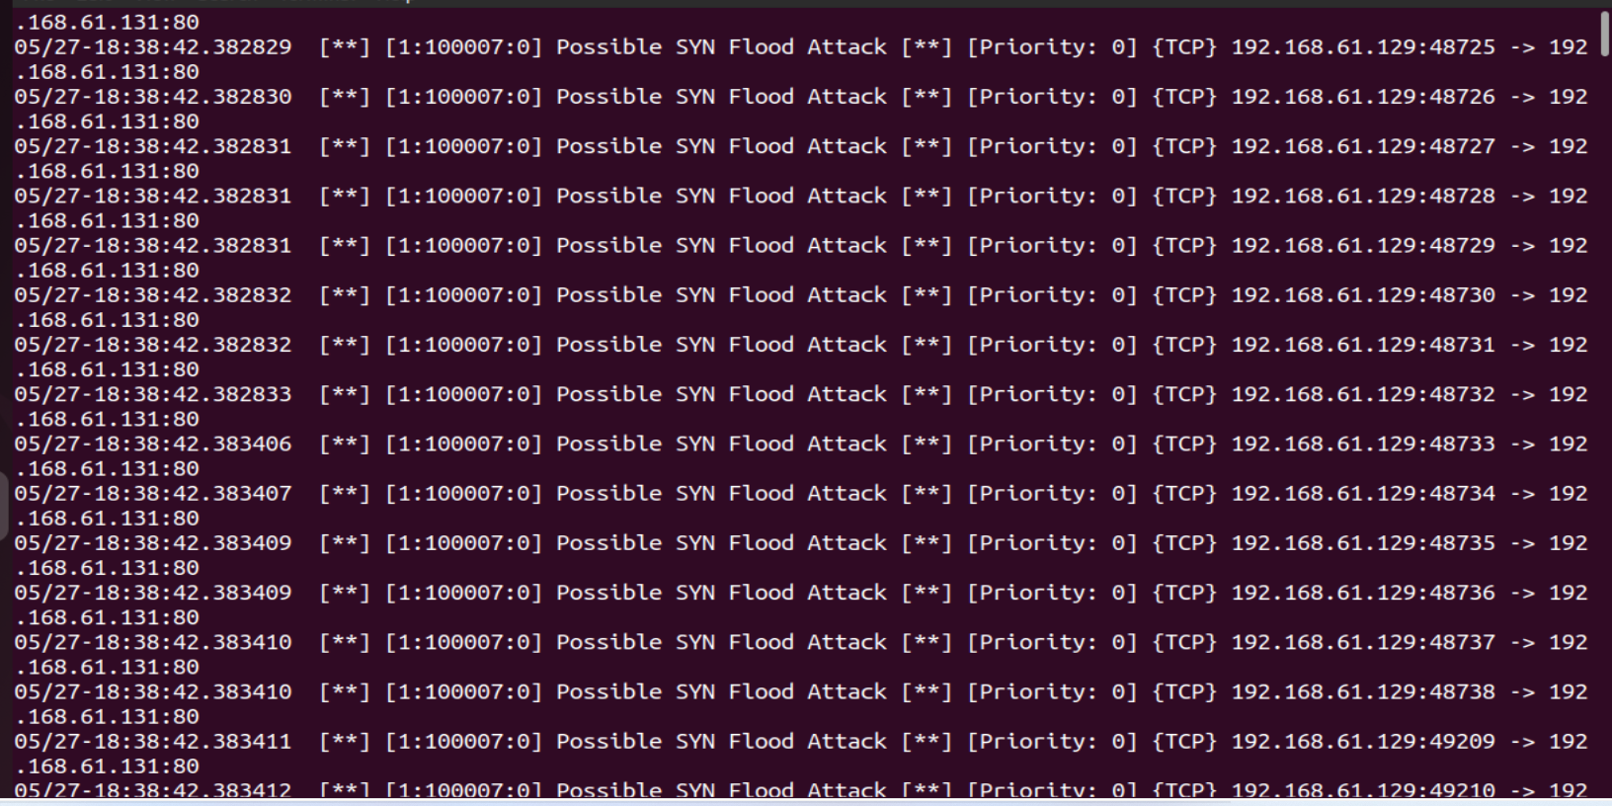
Implementation of Snort IDS
Running attacks:

Slide 23
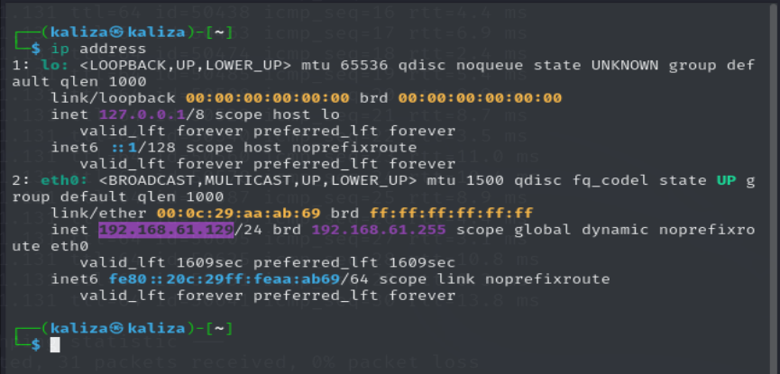
Implementation of Snort IDS
Running attacks:

Slide 24
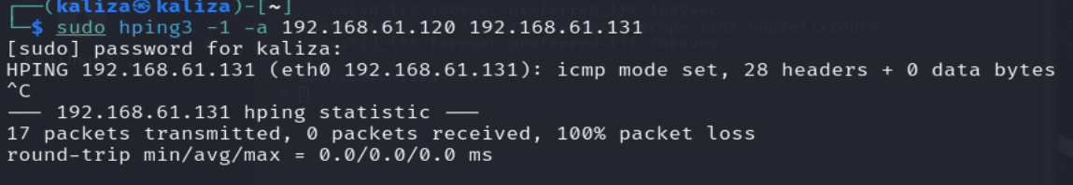
Implementation of Snort IDS
Running attacks:

Slide 25
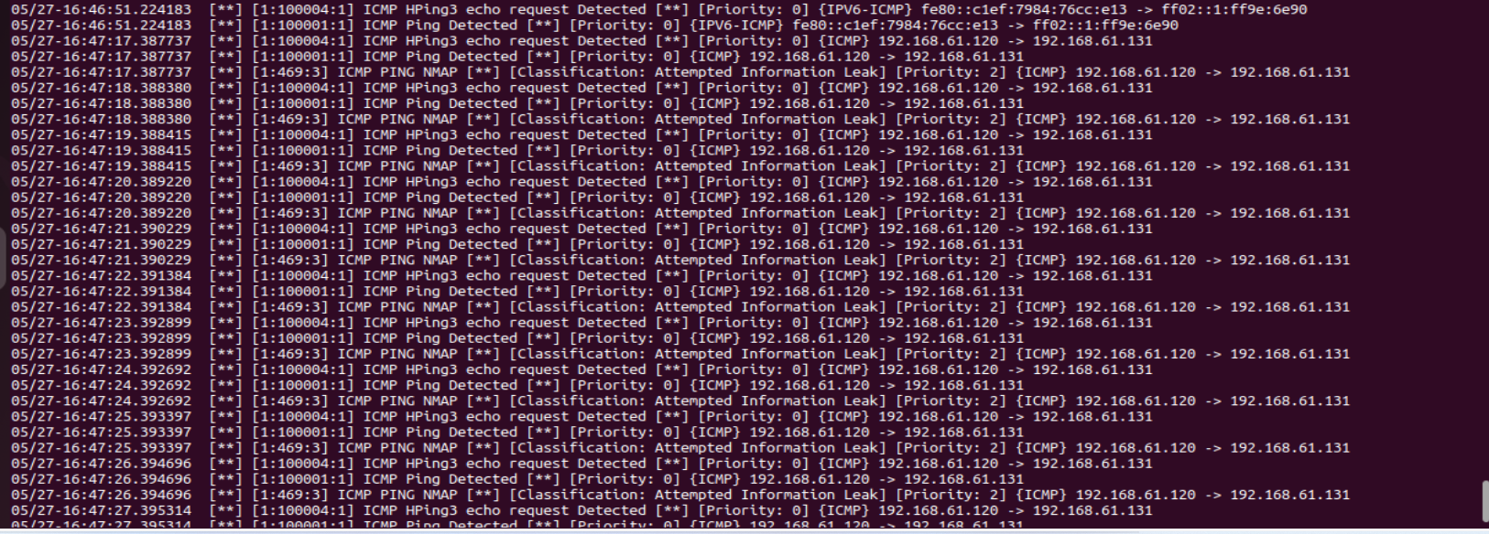
Implementation of Snort IDS
Running attacks:

Slide 26

Implementation of a Monotoring and Log Management System
Technologies Used:

Slide 27
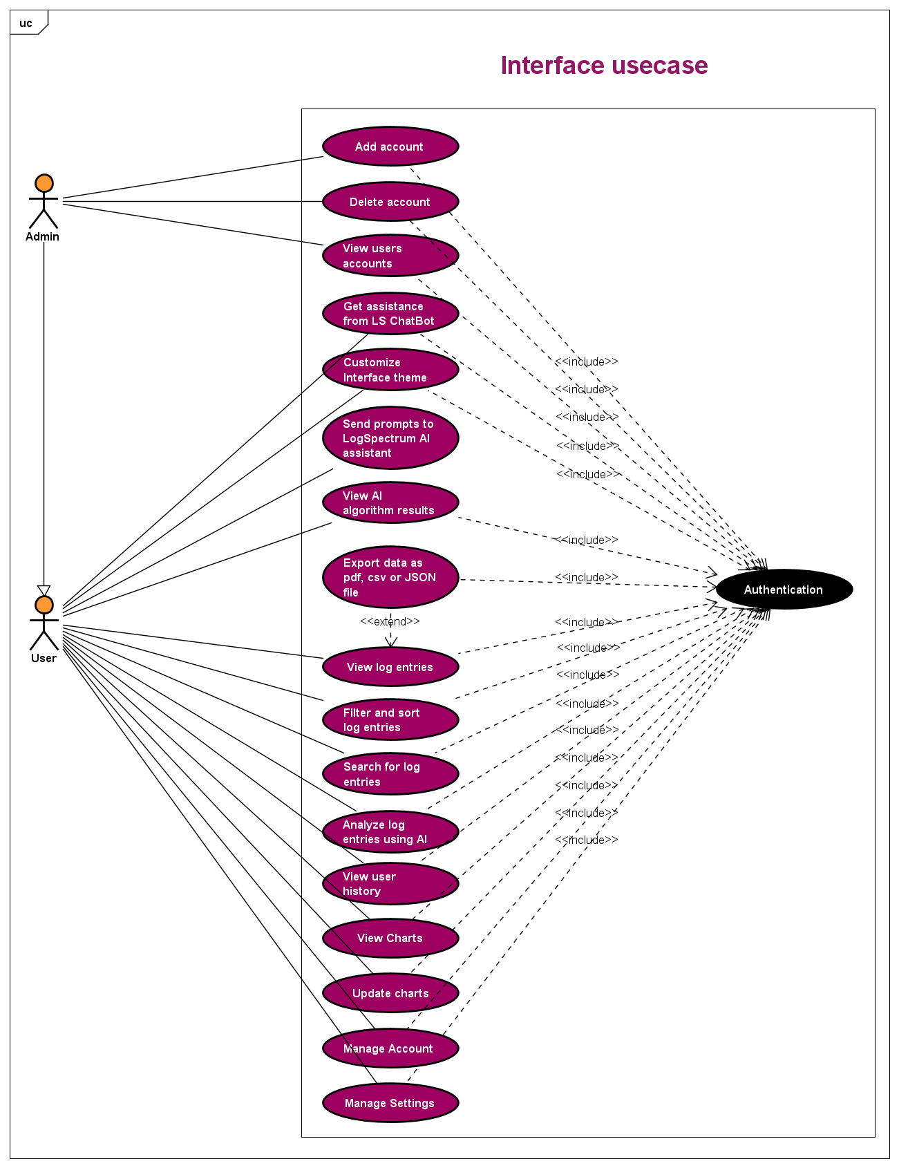
Implementation of a Monotoring and Log Management System
Related UML Diagrams:
Use Case:

Slide 28
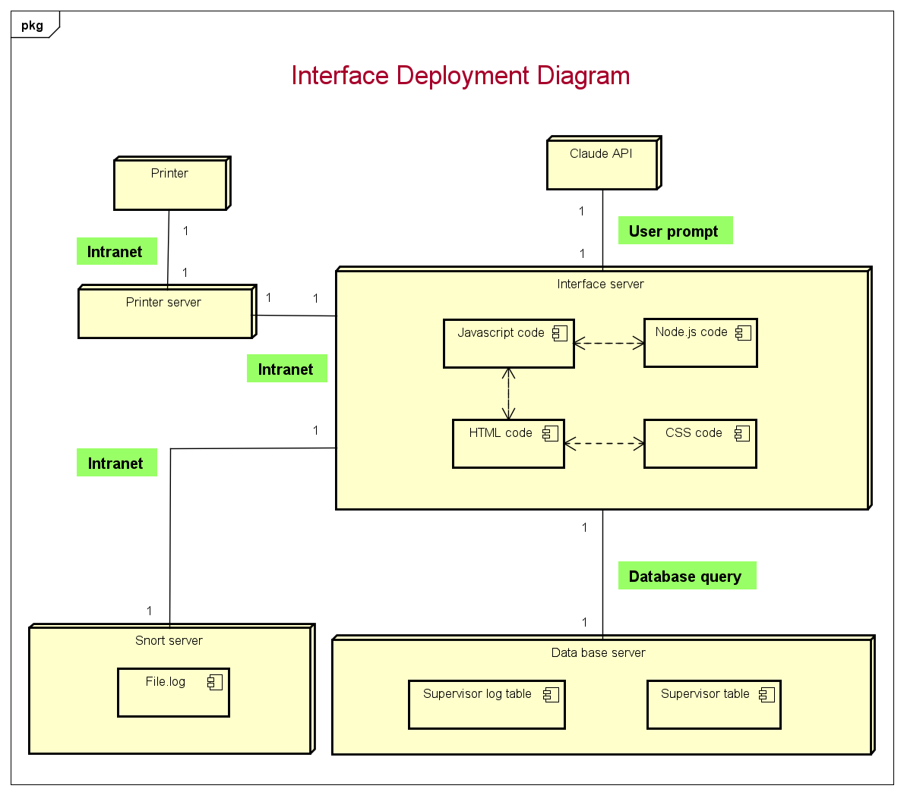
Implementation of a Monotoring and Log Management System
Related UML Diagrams:
deployement diagram:

Slide 29

Implementation of a Monotoring and Log Management System
Interface Design:
Login page

Slide 30
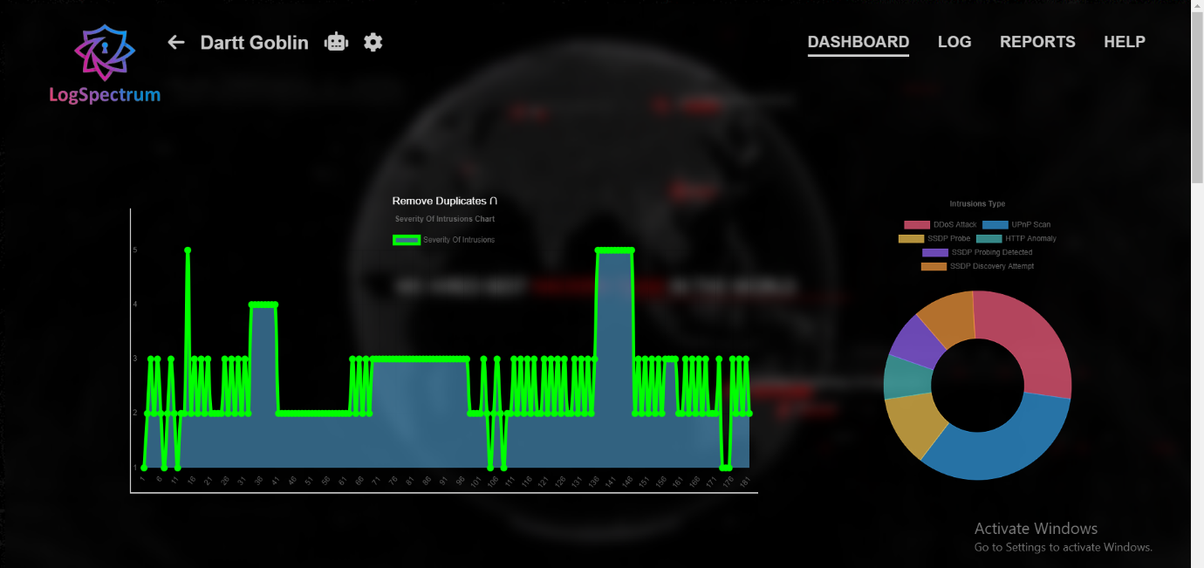
Implementation of a Monotoring and Log Management System
Interface Design:
Dashboard Page

Slide 31
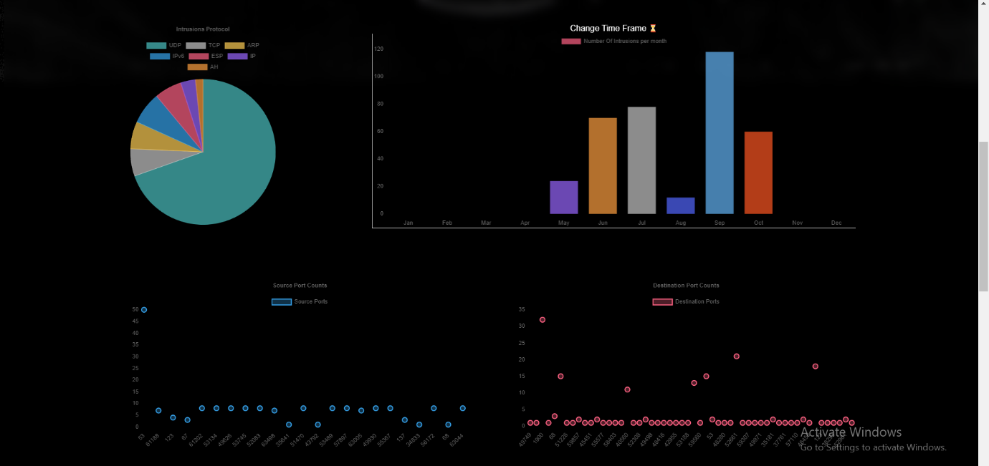
Implementation of a Monotoring and Log Management System
Interface Design:
Dashboard Page

Slide 32
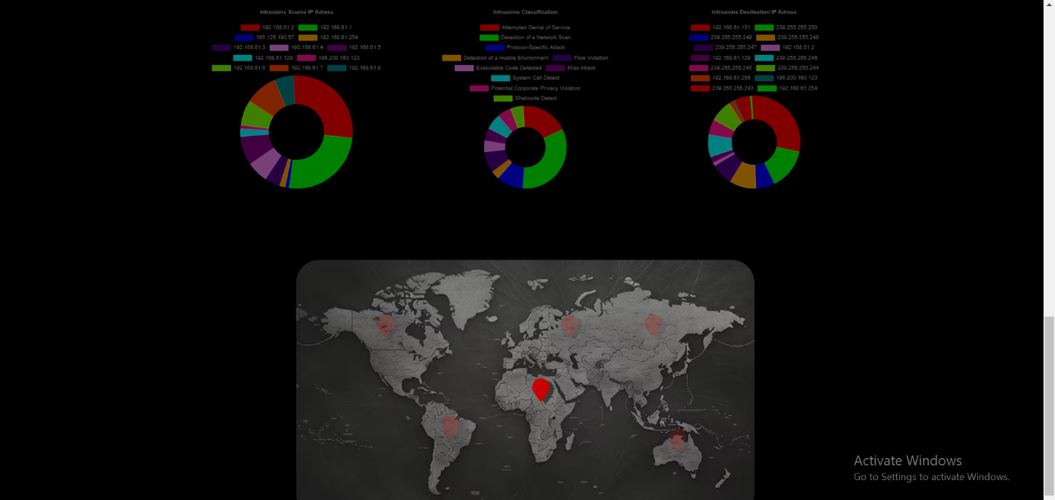
Implementation of a Monotoring and Log Management System
Interface Design:
Dashboard Page

Slide 33
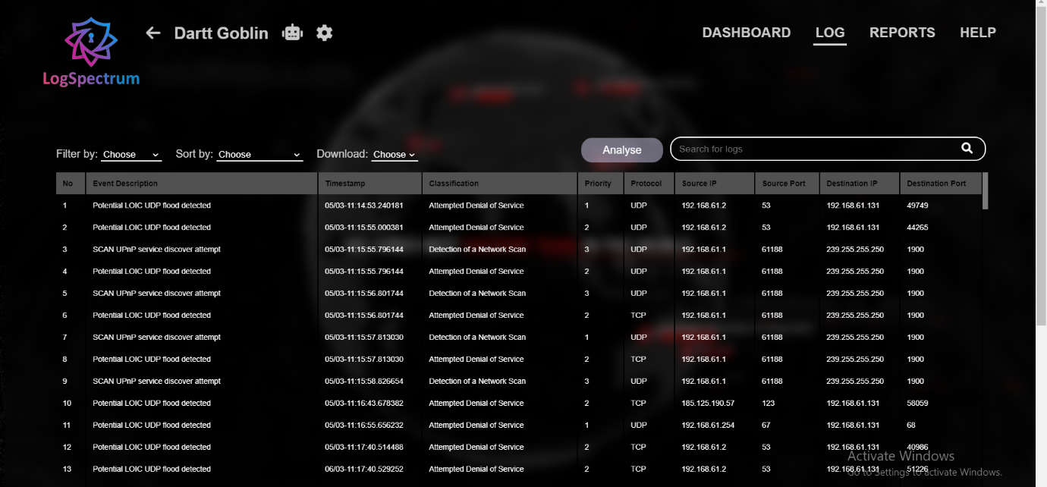
Implementation of a Monotoring and Log Management System
Interface Design:
Log Page

Slide 34

Implementation of a Monotoring and Log Management System
Interface Design:
Log Page
-Artificial intelligence

Slide 35
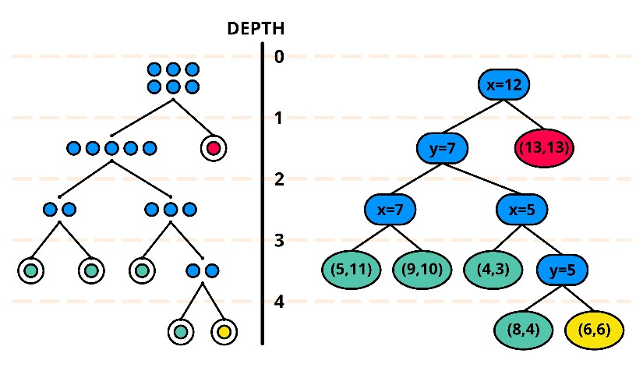
Implementation of a Monotoring and Log Management System
Interface Design:
Log Page
-Isolation forest algorithm

Slide 36
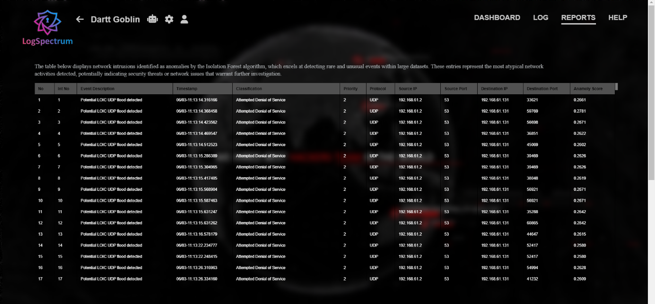
Implementation of a Monotoring and Log Management System
Interface Design:
Reports Page
-Anomaly intrusions table

Slide 37
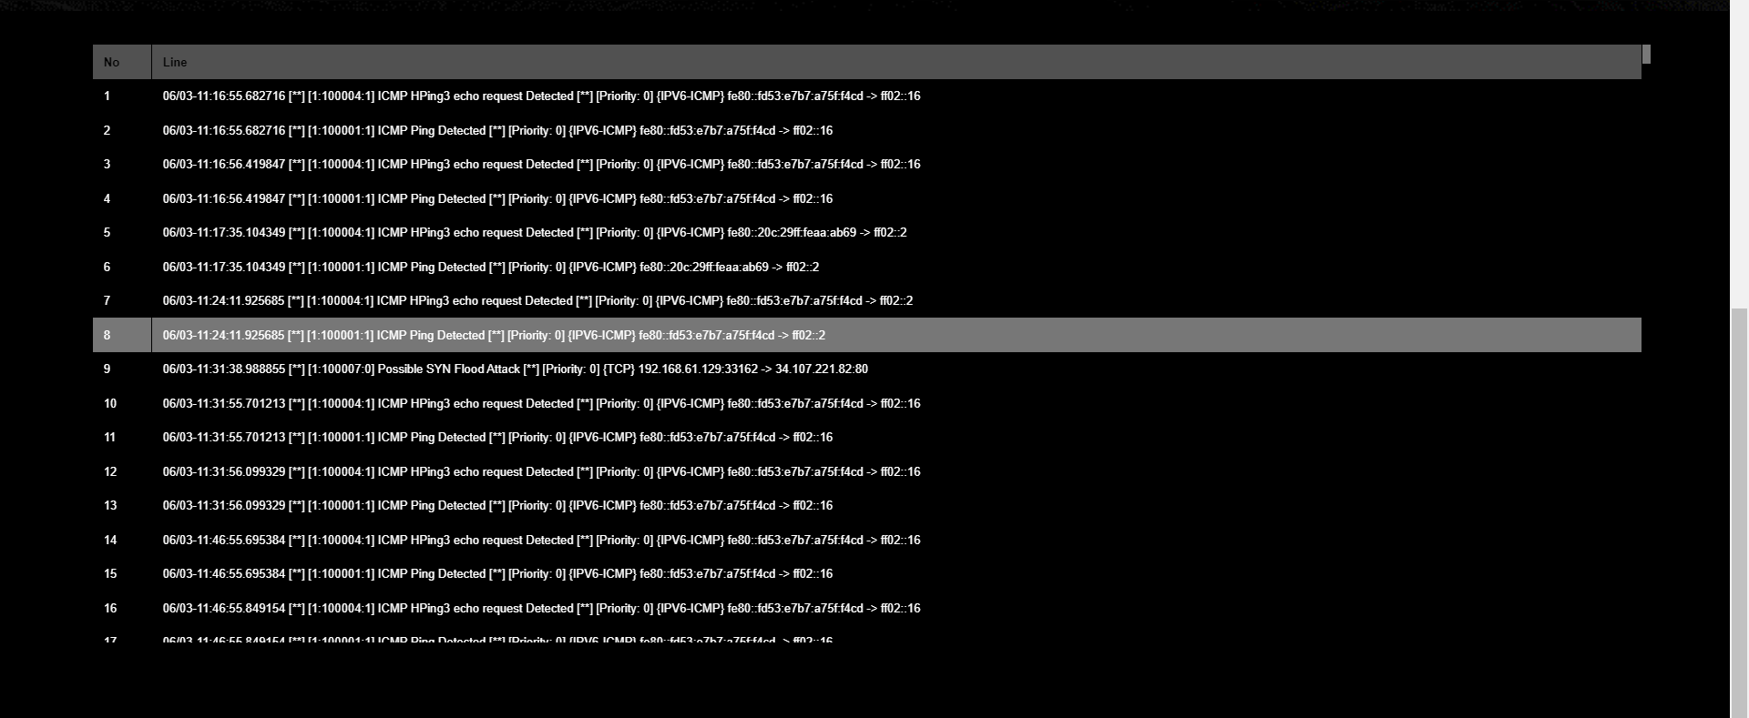
Implementation of a Monotoring and Log Management System
Interface Design:
Reports Page
-Abnormal intrusions table

Slide 38
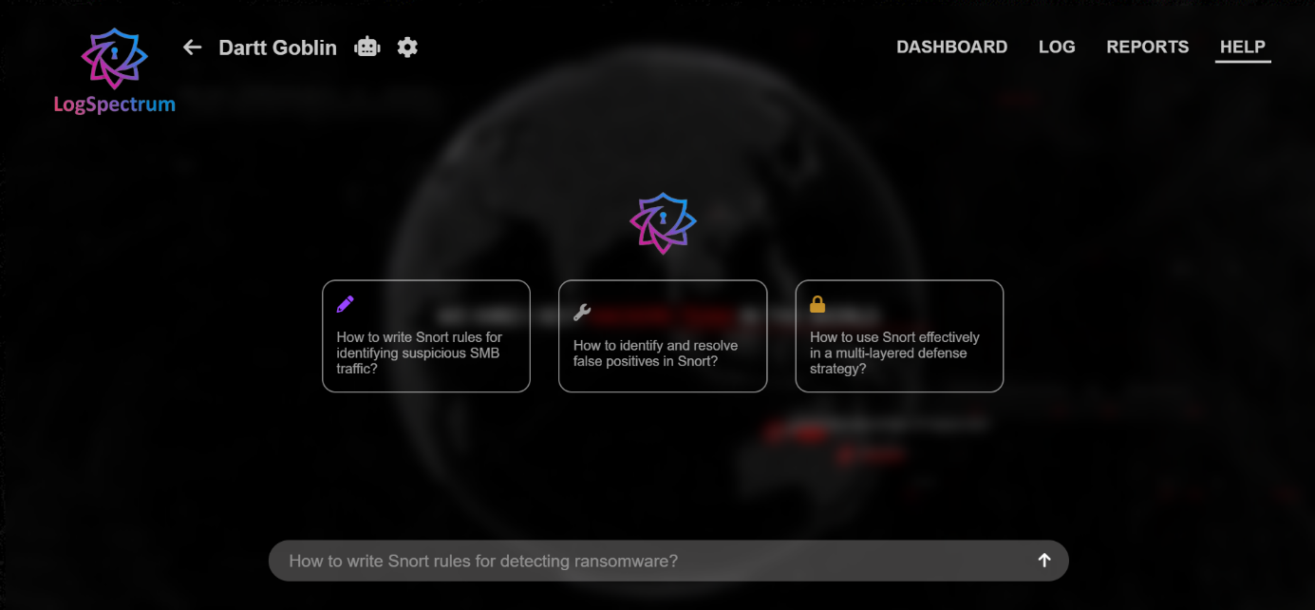
Implementation of a Monotoring and Log Management System
Interface Design:
Help Page

Slide 39
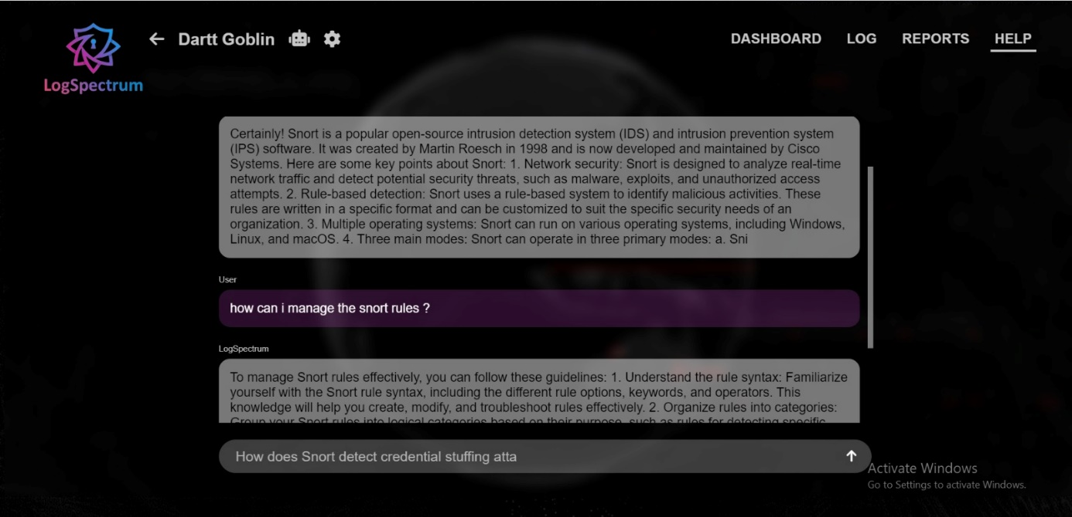
Implementation of a Monotoring and Log Management System
Interface Design:
Help Page

Slide 40
General Conclusion
In conclusion, this project highlights the crucial role of IDPS in protecting network infrastructures. By combining open-source tools with custom scripts, we created a responsive system that detects and mitigates real-time cyber threats. Our implementation also included a Monitoring and Log Management System to enhance analysis and response capabilities. Overcoming challenges in integration and optimization through iterative testing, our IDPS proved effective against attacks in a simulated environment. This project underscores the need for continuous innovation in cybersecurity.

